Slide 1



OPPORTUNITY REVIEW
DIRECT-TO-EMPLOYER GTM STRATEGY
Exploring a McLeod Health DTE Health Plan

Slide 2


Founded in 1979, headquartered in Indianapolis
Largest Independently-Owned Full-Service Third-Party Administrator
Specialize in Administration of Self-Funded Plans and Population Health Management​
Leader in the Direct-to-Employer Movement
We Know and Understand the Market
Experience Working with All Professional Teams: Agents, Networks, MGAs
The Key Family of Companies is a Vertically Integrated group of benefit related organizations
3,000+ Corporate Clients
3 Million Members under Management
700 Employees

Slide 3


MARKET LEADER
IN
PRIVATE LABELED
DTE PLANS
Louisville, KY
Cincinnati, OH
Bentonville, AR
Knoxville, TN
Meridian, MS
Fort Myers, FL

Slide 4


DIRECT-TO-EMPLOYER (DTE)
YOU Pick the Name of the Health Plan
YOU Determine the Fees Charged
YOU Practice the Medicine
YOU Receive the Profits
WE Make it Successful
Your Health Plan Focused on a Direct Relationship with Self-Funded Employers in Your Market

Slide 5
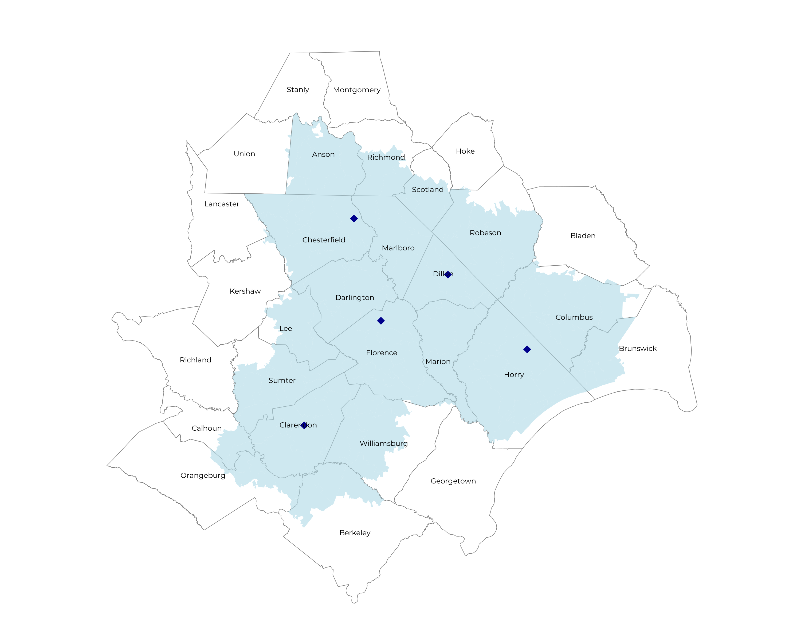
SIGNIFICANT OPPORTUNITY FOR PLAN GROWTH Researched for the below highlighted service area
Target Market 600+ Employers 120,000+ Employees 190,000+ Members
 | Employer Size Group (# of Employees)
Commercial Employers With Headquarters | 50-100 | 101-200 | 201-400 | 401-1,000 | 1,001-3,000 | 3,000+
In Catchment Area | 321 | 165 | 71 | 44 | 10 | 6
Total Employees at Employers | 50-100 | 101-200 | 201-400 | 401-1,000 | 1,001-3,000 | 3,000+
Headquartered in Catchment Area | 24,100 | 24,800 | 21,300 | 30,800 | 20,000 | 36,000
Total Members with Employers | 50-100 | 101-200 | 201-400 | 401-1,000 | 1,001-3,000 | 3,000+
Headquartered in Catchment Area | 43,400 | 44,600 | 38,300 | 55,400 | 36,000 | 64,800

Slide 6
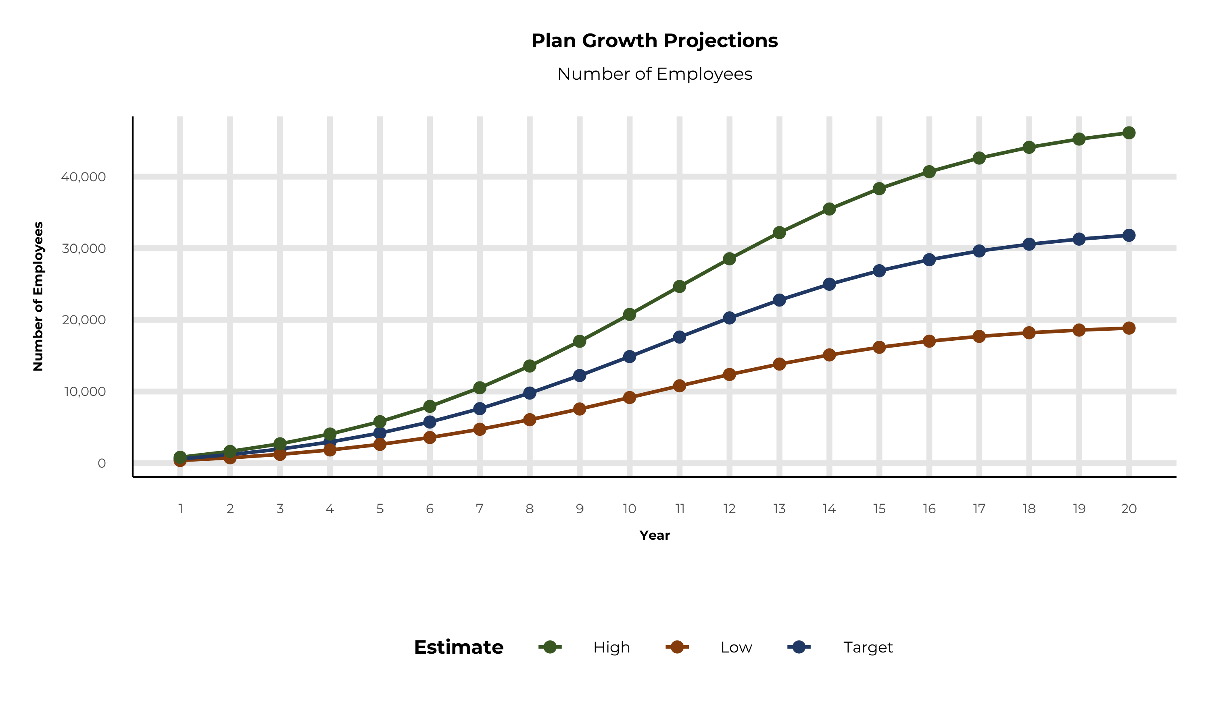
PLAN POTENTIAL GROWTH PATHS
Self Funded
218K
Insured
350K
Working Age
618K
Population
1,117K
Estimates includes the McLeod Health service area in Anson, Brunswick, Columbus, Richmond, Robeson, Scotland, Berkeley, Calhoun, Chesterfield, Clarendon, Darlington, Dillon, Florence, Horry, Lee, Marion, Marlboro, Orangeburg, Sumter, and Williamsburg Counties

Slide 7
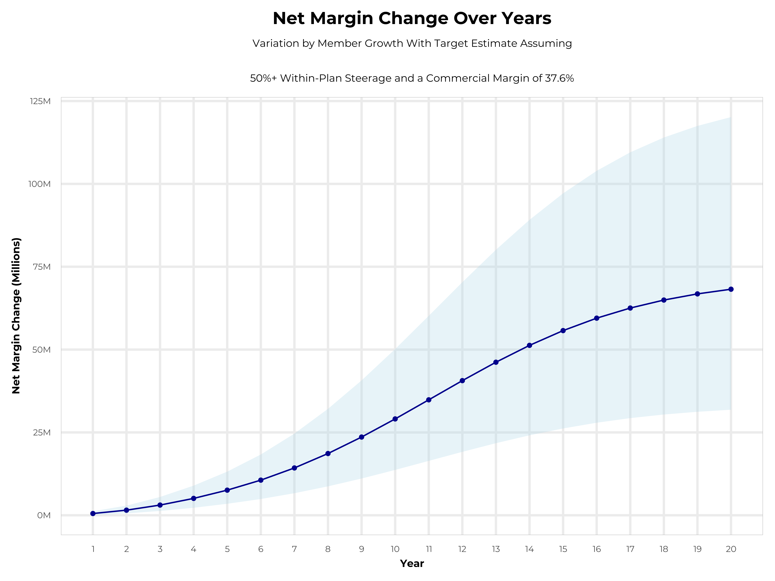
GROWING POWERFUL, LASTING PROFITABILITY
Early Stage
Gaining Name Recognition, Early Growth
New Revenue:
New Profit:
$12.98M
$4.74M
Growth Stage
Strong Reputation, Strong Growth
New Revenue:
New Profit:
$78.27M
$29.61M
Mature Stage
High Profitability, Market Saturation
New Revenue:
New Profit:
$161.62M
$61.29M

Slide 8
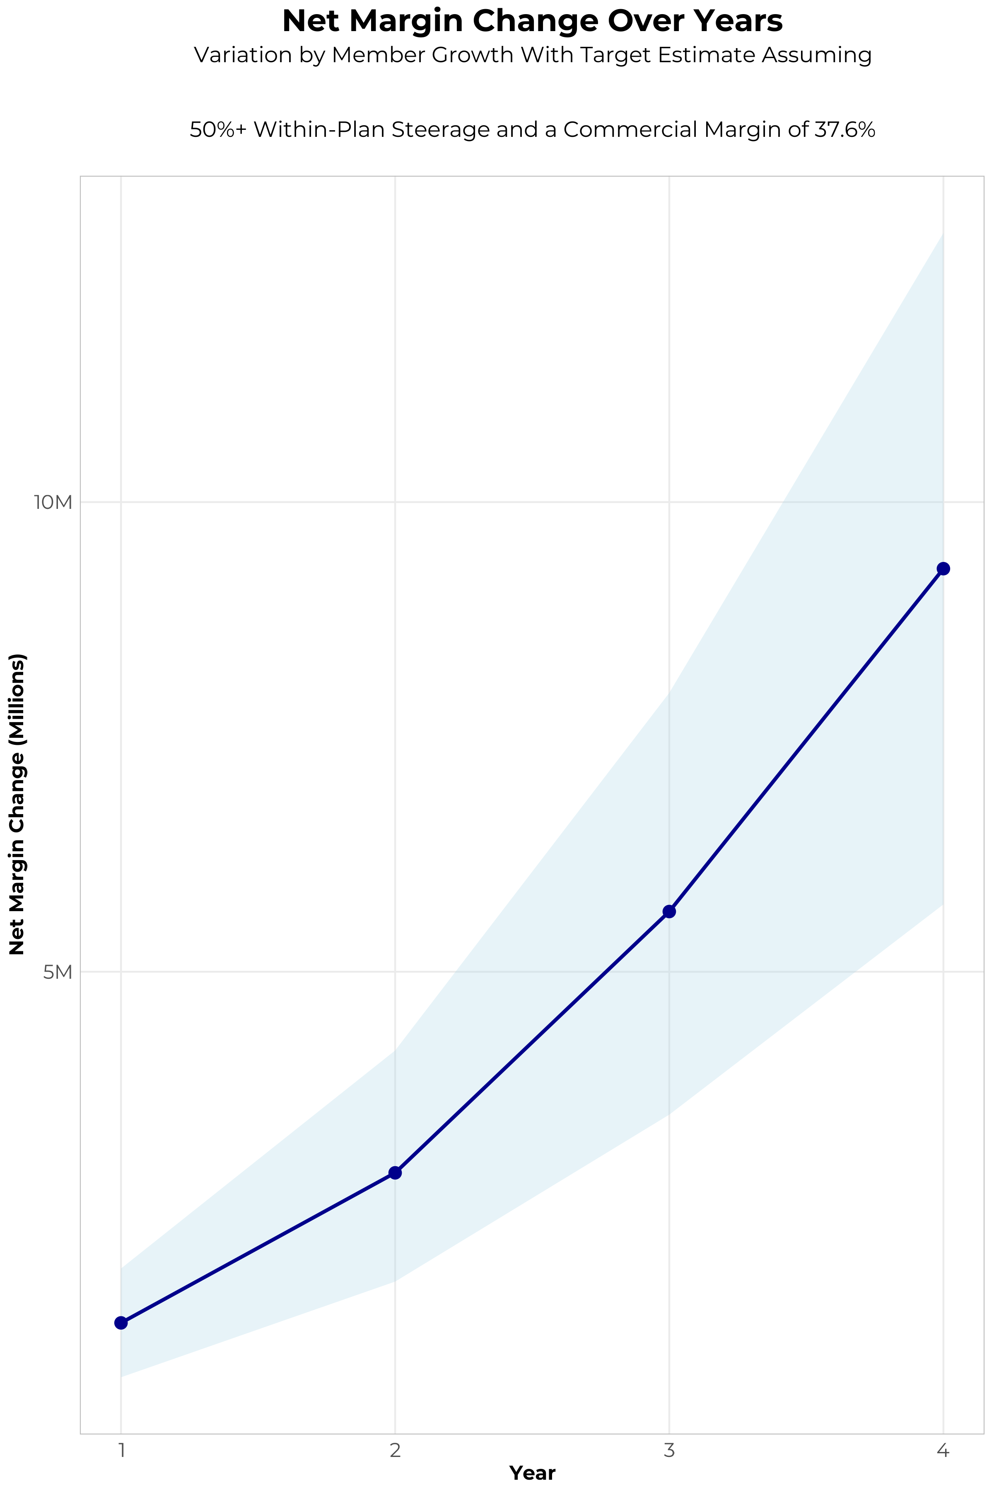
FOUR-YEAR PROJECTIONS
Target Member Growth | Target Member Growth | Target Member Growth | Target Member Growth | Target Member Growth
Metric | Year 1 | Year 2 | Year 3 | Year 4
Number of Members | 1,100 | 2,100 | 3,500 | 5,300
Incremental Margin | 1,578.9K | 3,014.3K | 5,779.1K | 9,407.5K
Network Access Fee | 13.2K | 25.2K | 42.0K | 63.6K
Implementation Fee (One-Time) | -150.0K | 0.0K | 0.0K | 0.0K
Sales and Marketing Costs | -180.0K | -180.0K | -180.0K | -180.0K
Net Margin Change | 1,262.1K | 2,859.5K | 5,641.1K | 9,291.1K
High Member Growth | High Member Growth | High Member Growth | High Member Growth | High Member Growth
Metric | Year 1 | Year 2 | Year 3 | Year 4
Number of Members | 1,500 | 3,000 | 4,900 | 7,300
Incremental Margin | 2,153.1K | 4,306.2K | 8,090.8K | 12,957.6K
Network Access Fee | 18.0K | 36.0K | 58.8K | 87.6K
Implementation Fee (One-Time) | -150.0K | 0.0K | 0.0K | 0.0K
Sales and Marketing Costs | -180.0K | -180.0K | -180.0K | -180.0K
Net Margin Change | 1,841.1K | 4,162.2K | 7,969.6K | 12,865.2K
Low Member Growth | Low Member Growth | Low Member Growth | Low Member Growth | Low Member Growth
Metric | Year 1 | Year 2 | Year 3 | Year 4
Number of Members | 700 | 1,300 | 2,200 | 3,300
Incremental Margin | 1,004.8K | 1,866.0K | 3,632.6K | 5,857.5K
Network Access Fee | 8.4K | 15.6K | 26.4K | 39.6K
Implementation Fee (One-Time) | -150.0K | 0.0K | 0.0K | 0.0K
Sales and Marketing Costs | -180.0K | -180.0K | -180.0K | -180.0K
Net Margin Change | 683.2K | 1,701.6K | 3,479.0K | 5,717.1K

Slide 9
DIRECT-TO-EMPLOYER STRATEGY: ONLY AVAILABLE TO PREMIER HEALTH SYSTEMS
STRONG Brand Quality
EXTENSIVE Patient Access
AFFORDABLE Value Pricing
EXCELLENT Care Quality

Slide 10
MCLEOD HEALTH IS PATIENT RECOMMENDED
Health System | HCAHPS Recommendation Percentile | CMS Stars Percentile | Mortality Percentile | Readmission Percentile | KBA Brand Quality Score
McLeod Health | 58 | 65 | 71 | 53 | 66
Tidelands Health | 52 | 90 | 72 | 75 | 63
Medical University of South Carolina Health System | 54 | 36 | 77 | 52 | 62
Other Independent Hospitals | 48 | 31 | 69 | 55 | 62
ScionHealth | 41 | 63 | 69 | 52 | 60
HCA Healthcare | 30 | 31 | 81 | 54 | 54
Advocate Health | 24 | 30 | 62 | 59 | 54
UNC Health | 9 | 31 | 61 | 48 | 48
Prisma Health | 6 | 31 | 85 | 60 | 45
Based on quality measures and HCAHPS feedback, KBA estimates that McLeod Health has the strongest brand quality in Anson, Brunswick, Columbus, Richmond, Robeson, Scotland, Berkeley, Calhoun, Chesterfield, Clarendon, Darlington, Dillon, Florence, Horry, Lee, Marion, Marlboro, Orangeburg, Sumter, and Williamsburg Counties.

Slide 11
PROJECTED PLAN GROWTH
Year | Employees | Members | Percent of Members Choosing McLeod Health for Inpatient Care | Percent of Members Choosing McLeod Health for Outpatient Care
1 | 600 | 1,100 | 60% | 50%
2 | 1,200 | 2,200 | 60% | 50%
3 | 2,000 | 3,600 | 65% | 55%
4 | 3,000 | 5,400 | 67% | 58%
5 | 4,200 | 7,600 | 68% | 60%
6 | 5,700 | 10,300 | 68% | 60%
7 | 7,600 | 13,700 | 69% | 61%
8 | 9,800 | 17,600 | 69% | 62%
9 | 12,200 | 22,000 | 69% | 62%
10 | 14,900 | 26,800 | 70% | 63%
11 | 17,600 | 31,700 | 70% | 63%
12 | 20,300 | 36,500 | 70% | 64%
13 | 22,800 | 41,000 | 71% | 64%
14 | 25,000 | 45,000 | 71% | 65%
15 | 26,900 | 48,400 | 71% | 66%
16 | 28,400 | 51,100 | 72% | 66%
17 | 29,600 | 53,300 | 72% | 66%
18 | 30,600 | 55,100 | 72% | 67%
19 | 31,300 | 56,300 | 72% | 67%
20 | 31,800 | 57,200 | 72% | 67%
KBA currently estimates that McLeod Health has 29% inpatient market share, and 17% outpatient market compared to hospitals/clinics in the McLeod Health service area (see slide 8).
Based on previous DTE experience, KBA expects a significant bump in patient steerage to McLeod Health.
Additional steerage will occur from additional steerage patient benefits and the patient convenience card.
High estimates start nearly 10% higher than target with low estimates at 10% lower than target

Slide 12
YEAR 4 PROJECTED REVENUE AND PROFIT
Pre-DTE Cohort of 5,300 Employees | Inpatient | Outpatient | Professional | Total
Revenue† | $ 4,961,589 | $ 5,273,345 | $ 2,462,607 | $ 12,697,541
Net Income‡ | $ 1,865,558 | $ 1,982,778 | $ 925,940.3 | $ 4,774,276
† Assuming proportional revenues from market shares of 29% (inpatient) and 17% (outpatient)
‡ Conservatively assuming a commercial margin of 37.6% (80% of the estimated commercial margin)
With DTE | Inpatient | Outpatient | Professional | Total
Revenue⁰ | $ 11,375,462 | $ 17,841,267 | $ 8,331,720 | $ 37,548,449
Net Income* | $ 4,277,174 | $ 6,708,316 | $ 3,132,727 | $ 14,118,217
⁰ Assuming 67% inpatient and 58% market steerage based on KBA narrow network DTE experience (see previous slide)
* Conservatively assuming a commercial margin of 37.6%, with a 10 percentage-point reduction to reflect competitive-edge rates and a 10 percentage-point increase due to lower billing costs and higher patient responsibility collections because of the member convenience card.
Total Increase in Net Income | $ 9,343,941
Network Access Fee (Revenue) of $1 PMPM | $ 63,600
Total Profit Growth | $ 9,348,741
Minus Implementation Fee (One-Time) | -$ 0
Minus Sales and Marketing (Annual – Ongoing) | -$ 180,000
Total | $ 9,227,541

Slide 13





A PARTNER YOU CAN TRUST
OUR OBJECTIVES ARE ALIGNED
WE KNOW THE
MARKET
COMPLETELY TRANSPARENT
WE HAVE THE SOPHISTICATION AND INFRASTRUCTURE TO EFFECTIVELY COMPETE
Derek Moore, Senior Vice President – KBA
845-283-9973 * derek.moore@keybenefit.com

